Slide 1
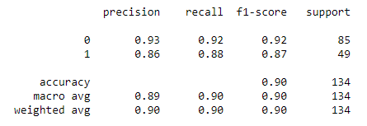
Random Forest - Classification
1. What is the overall performance of the model?
Accuracy – 0.90
2. What is the percentage of correctly classified?
Not Purchased (0) – 0.92
Purchased (1) – 0.88
3. What is the percentage of correctly and wrongly classified?
Not Purchased (0) – 0.93
Purchased (1) – 0.86
4. What is the overall performance (f1 – score) of ?
Not Purchased (0) – 0.92
Purchased (1) – 0.87
5. What is the average performance (macro – average) of ?
Precision – 0.89
Recall – 0.90
F1-score – 0.90
6. What is the proportion (participation) - weighted average of ?
Precision – 0.90
Recall – 0.90
F1-score – 0.90
7. What is the count (support) of ?
Not Purchased (0) – 85
Purchased (1) - 49

Slide 2
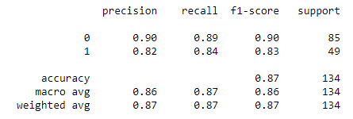
Decision Tree - Classification
1. What is the overall performance of the model?
Accuracy – 0.87
2. What is the percentage of correctly classified?
Not Purchased (0) – 0.89
Purchased (1) – 0.84
3. What is the percentage of correctly and wrongly classified?
Not Purchased (0) – 0.90
Purchased (1) – 0.82
4. What is the overall performance (f1 – score) of ?
Not Purchased (0) – 0.90
Purchased (1) – 0.83
5. What is the average performance (macro – average) of ?
Precision – 0.86
Recall – 0.87
F1-score – 0.86
6. What is the proportion (participation) - weighted average of ?
Precision – 0.87
Recall – 0.87
F1-score – 0.87
7. What is the count (support) of ?
Not Purchased (0) – 85
Purchased (1) - 49

Slide 3
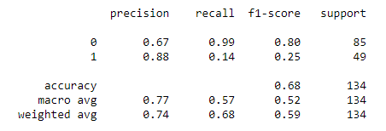
SVM Kernel - Classification
1. What is the overall performance of the model?
Accuracy – 0.68
2. What is the percentage of correctly classified?
Not Purchased (0) – 0.99
Purchased (1) – 0.14
3. What is the percentage of correctly and wrongly classified?
Not Purchased (0) – 0.67
Purchased (1) – 0.88
4. What is the overall performance (f1 – score) of ?
Not Purchased (0) – 0.80
Purchased (1) – 0.25
5. What is the average performance (macro – average) of ?
Precision – 0.77
Recall – 0.57
F1-score – 0.52
6. What is the proportion (participation) - weighted average of ?
Precision – 0.74
Recall – 0.68
F1-score – 0.59
7. What is the count (support) of ?
Not Purchased (0) – 85
Purchased (1) - 49

Slide 4
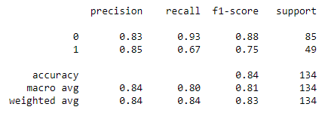
K Near Neighbour - Classification
1. What is the overall performance of the model?
Accuracy – 0.84
2. What is the percentage of correctly classified?
Not Purchased (0) – 0.93
Purchased (1) – 0.67
3. What is the percentage of correctly and wrongly classified?
Not Purchased (0) – 0.83
Purchased (1) – 0.85
4. What is the overall performance (f1 – score) of ?
Not Purchased (0) – 0.88
Purchased (1) – 0.75
5. What is the average performance (macro – average) of ?
Precision – 0.84
Recall – 0.80
F1-score – 0.81
6. What is the proportion (participation) - weighted average of ?
Precision – 0.84
Recall – 0.84
F1-score – 0.83
7. What is the count (support) of ?
Not Purchased (0) – 85
Purchased (1) - 49

Slide 5
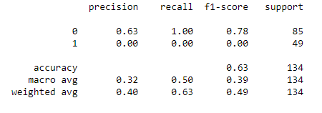

Naive Bayes- Classification
Model is incorrect because the Purchased value is ‘0’ i.e., True Purchased value is ‘0’ in the matrix

